Slide 1

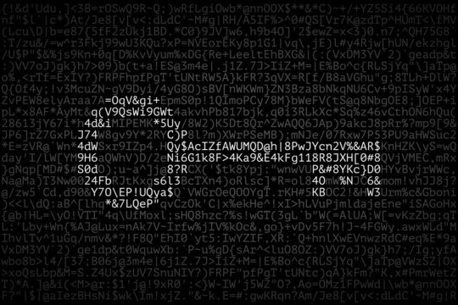
Encryption in Action
Real-World Case Study
Presented by Jeytha Sahana

Slide 2
Introduction
Overview
This presentation focuses on a t- shirt company that is currently building its foothold in the industry of textiles and garments. They have also invested in their digital presence and henceforth also look forward to expanding their offline stores in various other locations across the country.
Objective
Assess risks and apply encryption-based controls across customer data management, supply chain operations, and marketing communications.

Slide 3
Business Operation 1: Customer and Employee Data Management
Employee Data
Contact
Residence
Social Security Number
Tax Information
Bank account information
Performance records
Customer Data
Contact
Residence
Email
Login password/Username
Browsing choices

Slide 4

Data at Rest
Risk: Unauthorized access to stored personal data
Control: Encrypt databases using AES-256; conduct access audits
Data in Use
Risk: Insider threats from employees misusing personal data
Control: Apply role-based access control (RBAC); monitor user activity
Data in Transit
Risk: Data interception during transfers (e.g., password resets)
Control: Use TLS encryption for all data transmission

Slide 5
Business Operation 2: Supply Chain Operations and Online Storefront
Supply Chain Data
Inventory levels
Production levels
Order status
Financial information
Sales numbers
Online Transactions Data
Transaction information
Payment information
Billing shipping information
Item level data
Contact information
Address

Slide 6

Data at Rest:
Risk: Compromised inventory or production data
Control: Encrypt supply chain databases with AES-256
Data in Use:
Risk: Insider fraud or system manipulation
Control: Use RBAC and audit logs for activity tracking
Data in Transit:
Risk: Order information intercepted during transfers
Control: Apply TLS encryption and secure APIs

Slide 7
Business Operation 3: Marketing and Communication
Marketing
Product
Price
Promotion strategies
Web analytics - visitors, sessions, clicks, engagements, downloads, purchases, form
Market research - competitor analysis, industry trends, and consumer preferences
Customer Communication
Customer feedback
Customer service - Complaints/ Returns/ Refunds
Customer Tie Ups

Slide 8

Data at Rest
Risk: Exposed analytics reports stored on internal systems
Control: Encrypt stored analytics data and restrict access
Data in Use
Risk: Employees mishandling customer contact information
Control: Apply role-based access and provide security awareness training
Data in Transit
Risk: MITM attacks during customer communication
Control: Use HTTPS protocols and encrypted emails

Slide 9
THANK YOU

